Slide 1
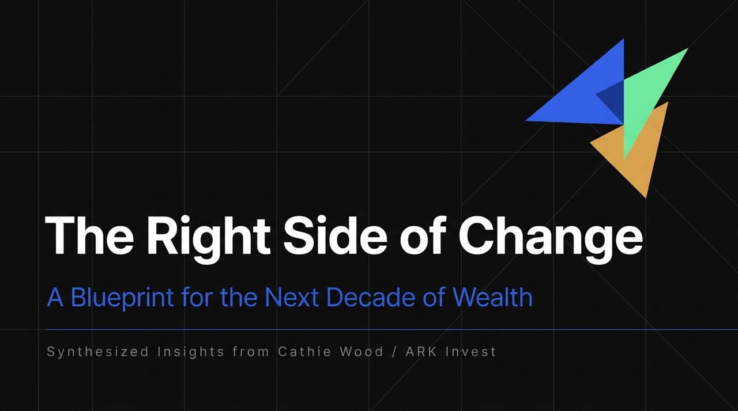
Notes:
https://www.youtube.com/watch?v=ZznpMh0DegE
Welcome everyone. Today we are diving into "The Right Side of Change"—ARK Invest’s overarching investment thesis led by Cathie Wood.
As Cathie Wood highlighted in her interview, we are currently experiencing the largest technological shift in human history driven by Artificial Intelligence.
The goal today is to explain how aligning your portfolio and career on the "right side of change" unlocks 10x long-term wealth potential, while holding legacy benchmark assets leaves you vulnerable to massive technological disruption.

Slide 2
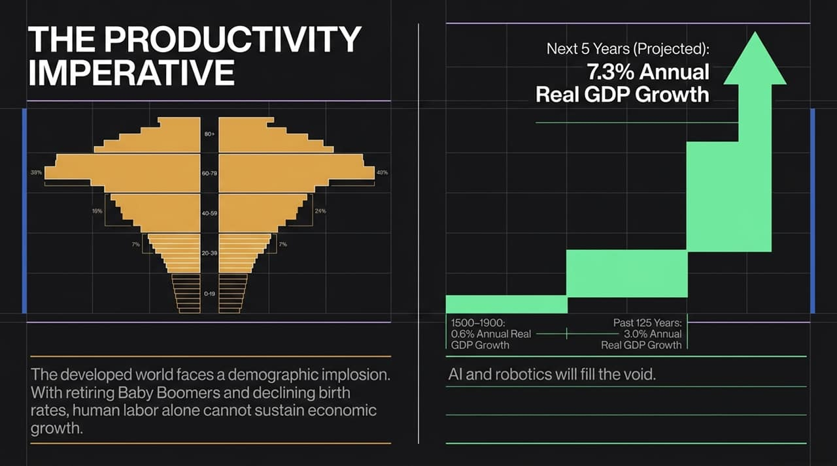
Notes:
Demographic Problem: The developed world—including the US, Europe, Japan, and China—faces an inverted demographic pyramid. With retiring Baby Boomers and declining birth rates, human labor alone cannot sustain future GDP growth.
Historical Context: From 1500 to 1900, world GDP grew at a mere 0.6% annually. The Industrial Revolution boosted that to 3.0% over the last 125 years.
The Future Void Filled by AI/Robotics: As Cathie Wood notes [00:22:34–00:24:20], the convergence of the 5 innovation platforms can accelerate global real GDP growth to 7.3% annually. AI and robotics will bridge the demographic gap by dramatically expanding productivity.

Slide 3
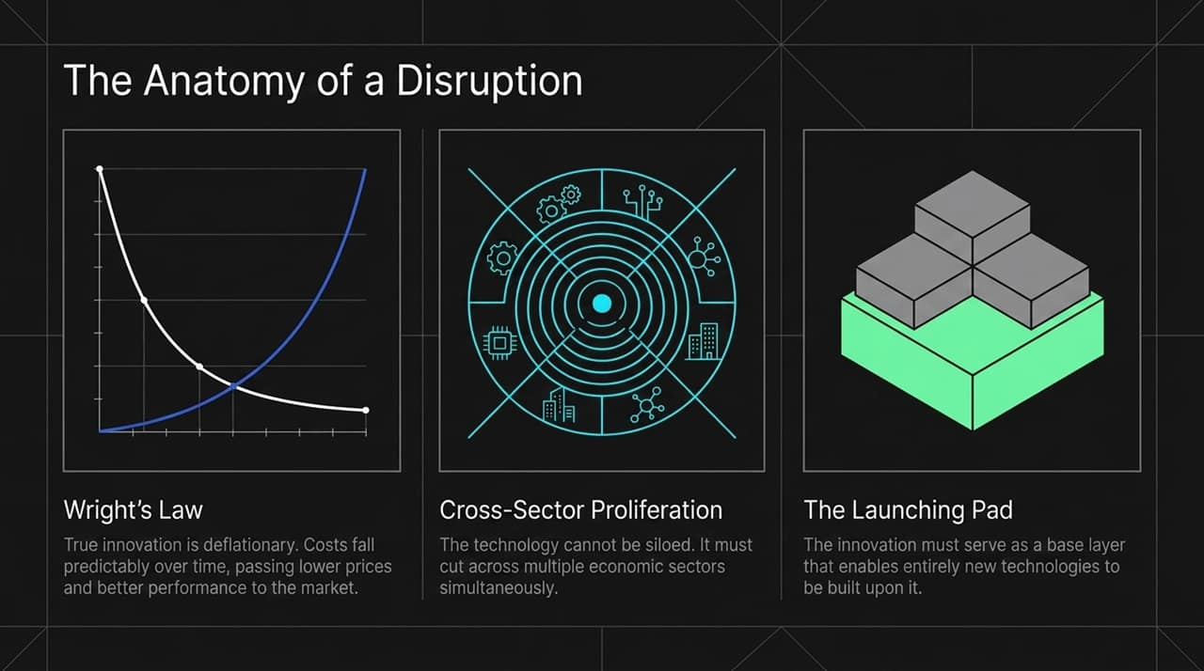
Notes:
How do we identify true disruptive platforms? Cathie Wood applies three core criteria:
Wright's Law: Technological innovation is naturally deflationary. Costs decline predictably as unit production doubles, passing lower prices or higher performance to consumers.
Cross-Sector Proliferation: Disruptive technology cannot remain in an isolated silo; it must cut across multiple sectors simultaneously.
Launching Pad Effect: Innovation must serve as a base layer for subsequent breakthroughs (e.g., DNA sequencing acted as the launching pad for CRISPR gene editing).

Slide 4
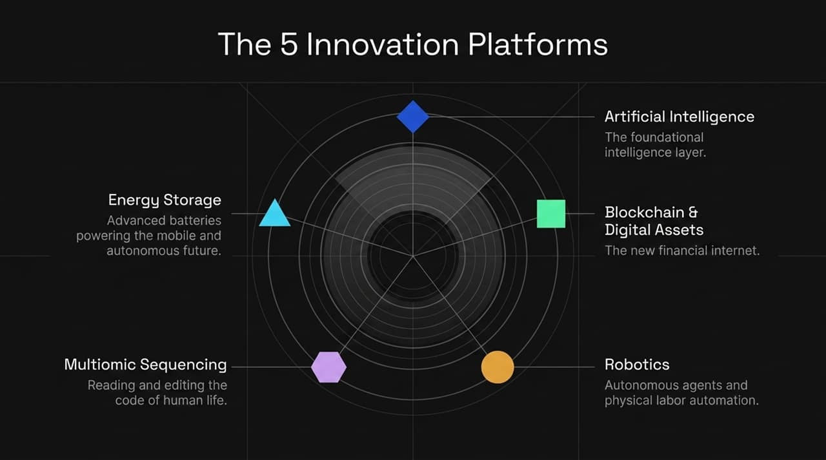
Notes:
ARK Invest centers its research around 5 fundamental innovation platforms:
Artificial Intelligence: The foundational software intelligence layer driving automated decision-making.
Energy Storage: Advanced battery technology powering mobility and untethered devices.
Blockchain & Digital Assets: The new financial rules-based internet infrastructure.
Multiomic Sequencing: Reading, understanding, and translating human genetic data.
Robotics: Autonomous physical execution in the real world.

Slide 5
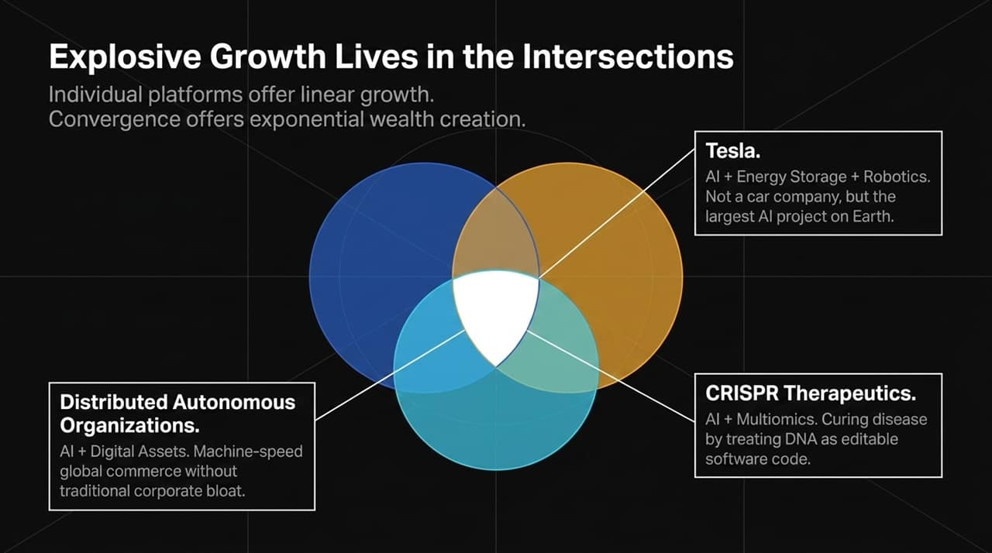
Notes:
Individual platforms offer linear growth, but convergence creates exponential wealth.
Tesla: Tesla is not a car company; it is the largest AI project on Earth, combining AI, Energy Storage, and Robotics to create autonomous taxi networks and humanoids.
DAOs / Digital Commerce: Combining AI with Digital Assets creates machine-speed global trade without middleman corporate bloat.
CRISPR Therapeutics: Combining AI with Multiomics treats DNA as editable code to permanently cure genetic diseases.

Slide 6
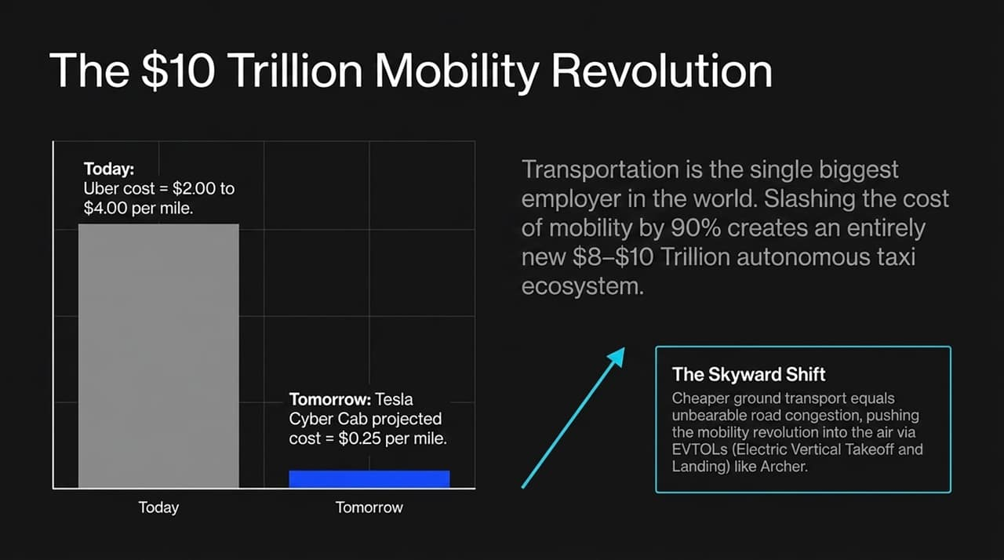
Notes:
Economic Scale: Transportation is the single largest employer category globally. The autonomous taxi market will become an $8 to $10 Trillion ecosystem in the next 5–10 years.
Cost Deflation: Uber currently costs $2.00–$4.00 per mile. Tesla's autonomous network will slash that cost to $0.25 per mile.
EVTOL Skyward Shift: Drastically reducing ground transit costs increases road usage and congestion. This naturally pushes urban aerial transit into EVTOLs like Archer Aviation.

Slide 7
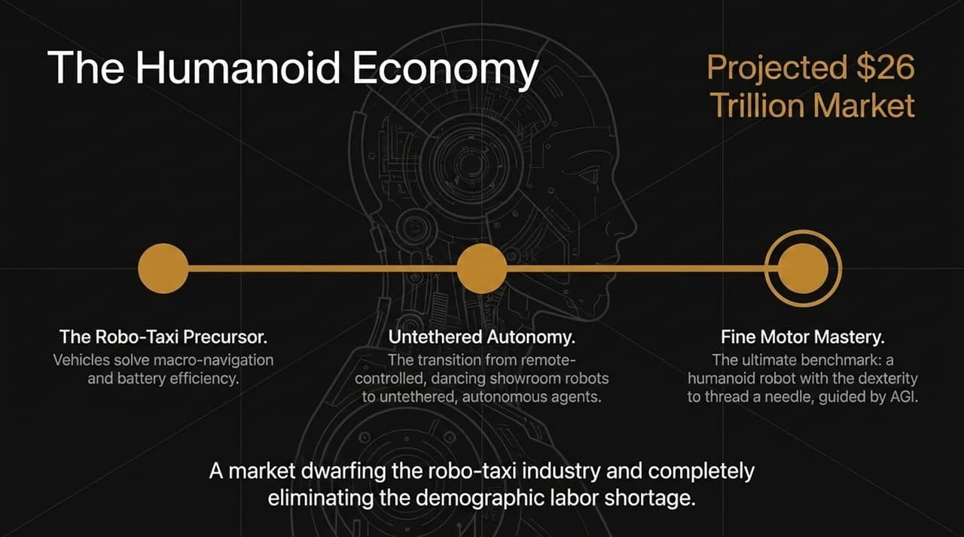
Notes:
Market Size: Humanoid robotics is projected to become a $26 Trillion market, far outpacing the robo-taxi market and offsetting structural demographic labor shortages.
Phases of Development:
Robo-Taxi Precursor: Solving vision navigation and battery density.
Untethered Autonomy: Transitioning away from tethered showroom demos to autonomous physical agents.
Fine Motor Mastery: Elon Musk’s ultimate operational benchmark—a humanoid robot with the dexterity to thread a needle guided by AGI.

Slide 8
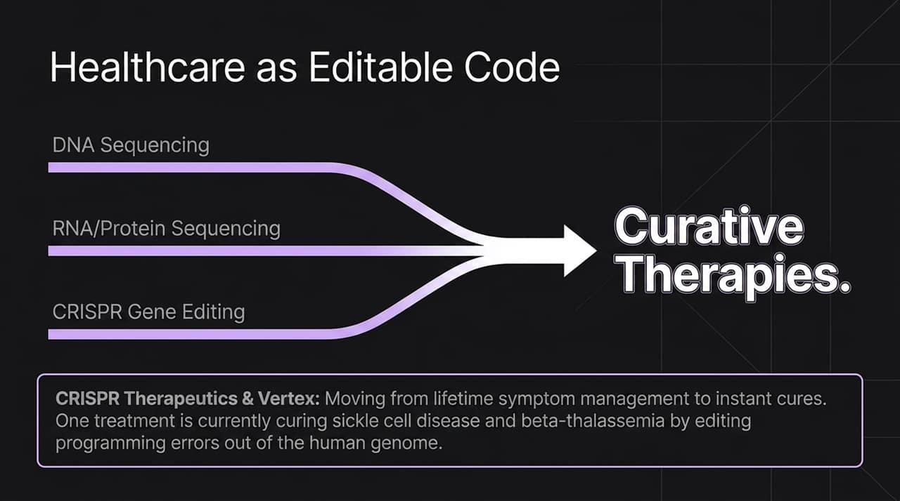
Notes:
Symptom Management vs. Instant Cures: Healthcare is shifting from lifetime disease management to single-treatment genetic cures.
CRISPR Therapeutics: By pairing multiomic sequencing with gene editing, CRISPR and Vertex have created a commercialized, single-session therapy curing Sickle Cell Disease and Beta-Thalassemia by directly editing programming errors in human DNA.

Slide 9
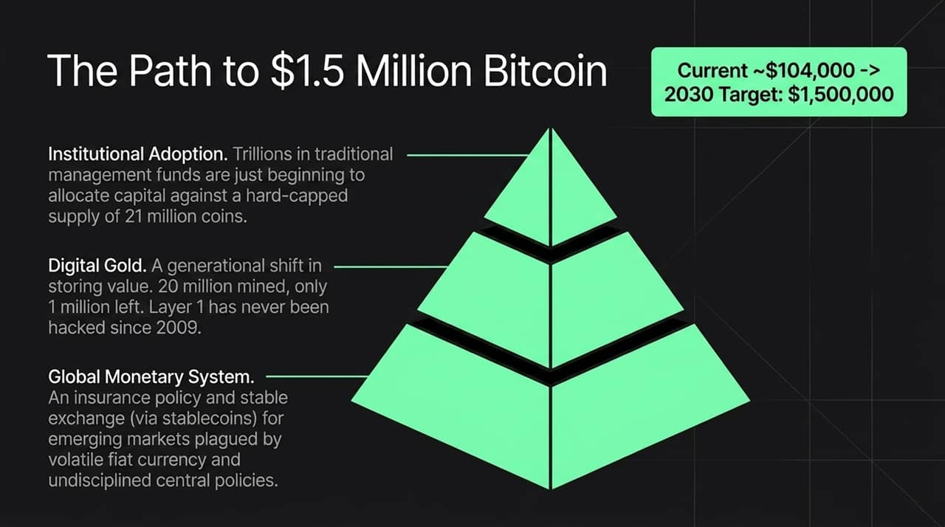
Notes:
Cathie Wood projects Bitcoin reaching $1.5 Million by 2030 through three key pillars:
Institutional Allocation: Following SEC ETF approvals, institutional funds with trillions in AUM are allocating to Bitcoin's fixed 21-million coin supply (with ~20M already mined).
Digital Gold: A generational wealth shift favoring internet-native rules-based stores of value. Its Layer 1 network has never been hacked since 2009.
Global Monetary Insurance: Provides financial security in emerging markets impacted by fiat inflation and irresponsible central banks.

Slide 10
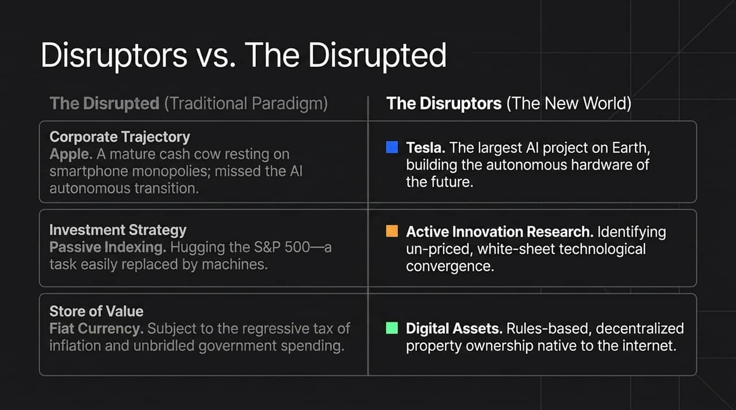
Notes:
Corporate Shift: Apple risks becoming a mature cash cow stuck in smartphone monopolies while missing the autonomous AI transition, whereas Tesla acts as the primary hardware/AI engine.
Indexing Risk: Hugging traditional S&P 500 benchmarks relies on historical data—a strategy easily replicated or disrupted by AI machines.
Human Capital & Value: Traditional coding is being replaced by natural language "vibe coding". Fiat currency is eroded by inflation, whereas digital assets establish rules-based property rights.

Slide 11
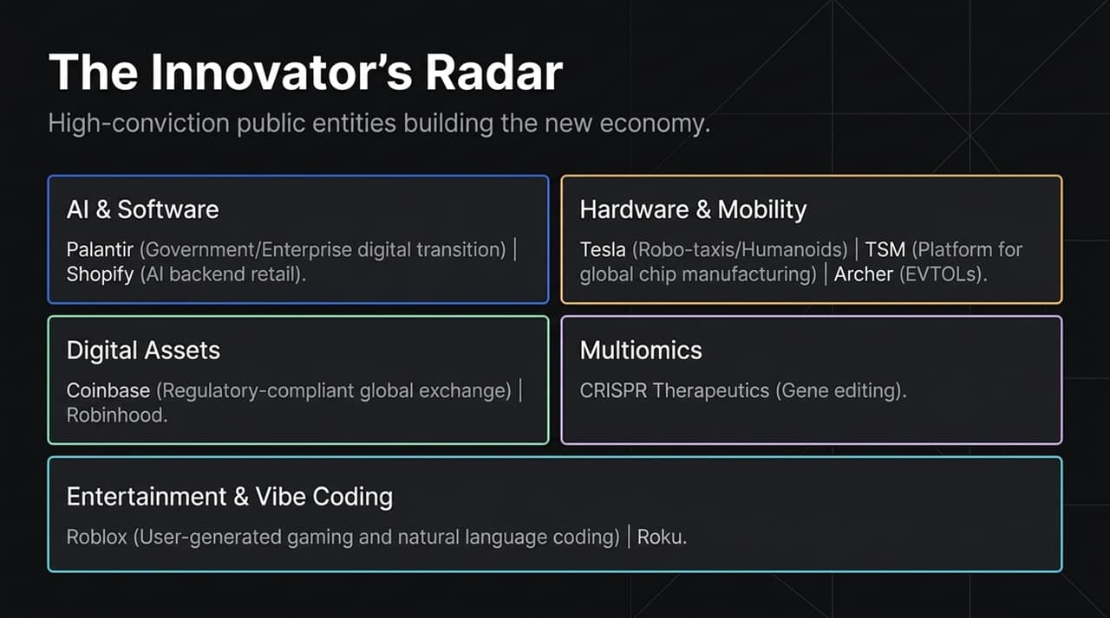
Notes:
High-conviction public equities executing this transformation:
Palantir & Shopify: Enterprise/government AI integration and backend AI retail infrastructure.
TSM & Archer: The essential chip manufacturing foundry and pioneering EVTOL mobility.
Coinbase: Regulatory-compliant infrastructure for digital asset derivatives and global financial rails.
Roblox: User-generated gaming platform serving as an early training ground for vibe coding and social interaction.

Slide 12
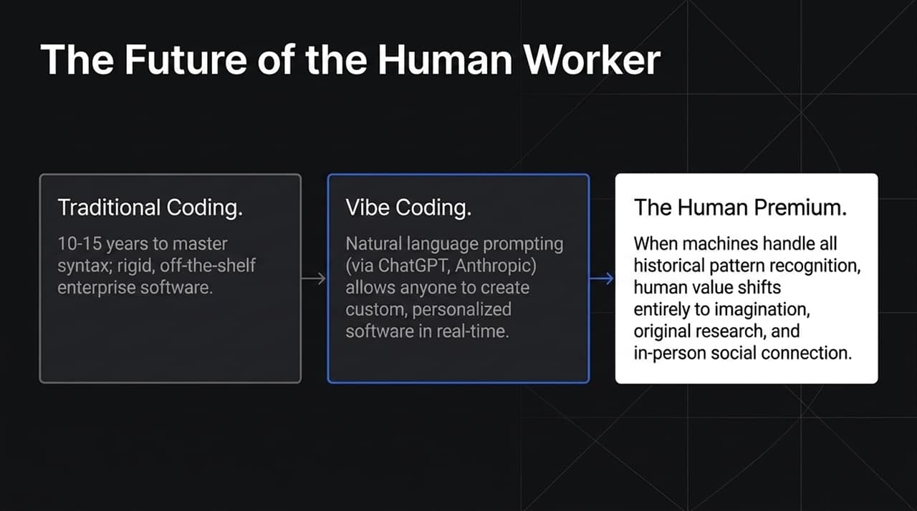
Notes:
Vibe Coding: Natural language prompting in tools like ChatGPT, Claude, and Replit allows individuals to create tailored, customized software without learning syntax over 10–15 years.
The Human Premium: As AI handles historical pattern recognition and routine tasks, human capital shifts toward imagination, original research, emotional connection, and high-touch social experiences.

Slide 13
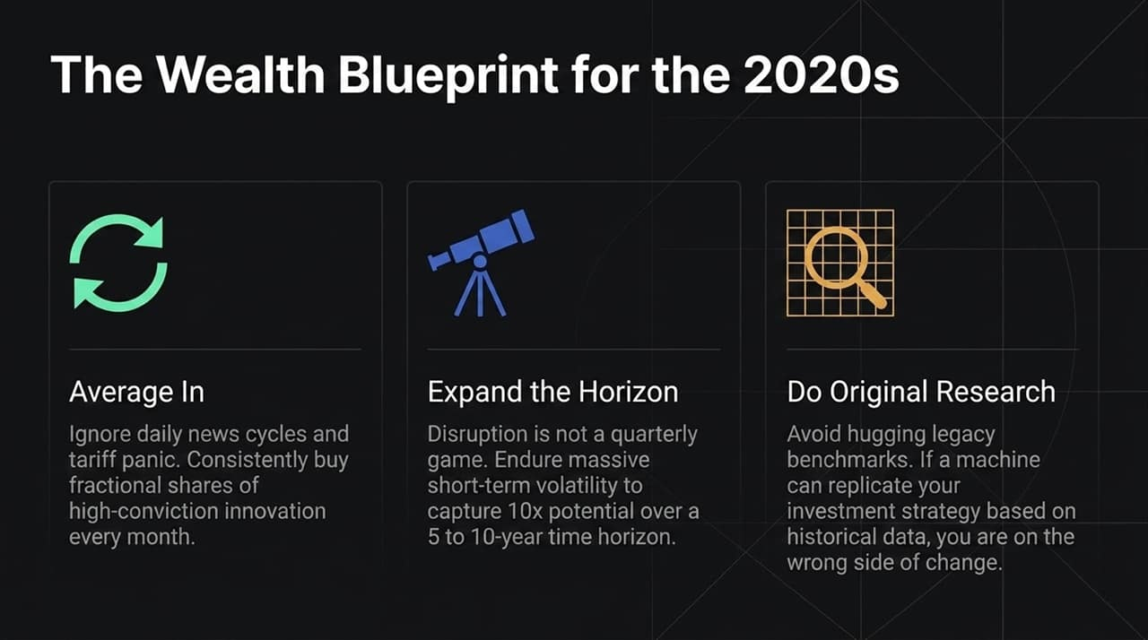
Notes:
Actionable Execution:
Dollar-Cost Average: Ignore short-term noise, tariff headlines, and political volatility; systematically average into high-conviction innovation assets.
5–10 Year Time Horizon: Accept short-term volatility to capture long-term 10x growth potential.
Do Original Research: Do not replicate outdated benchmarks.
Closing Quote: "Seize the moment. Grab hold of these new technologies... if you are on the right side of change, the opportunities are going to be enormous."

Slide 14
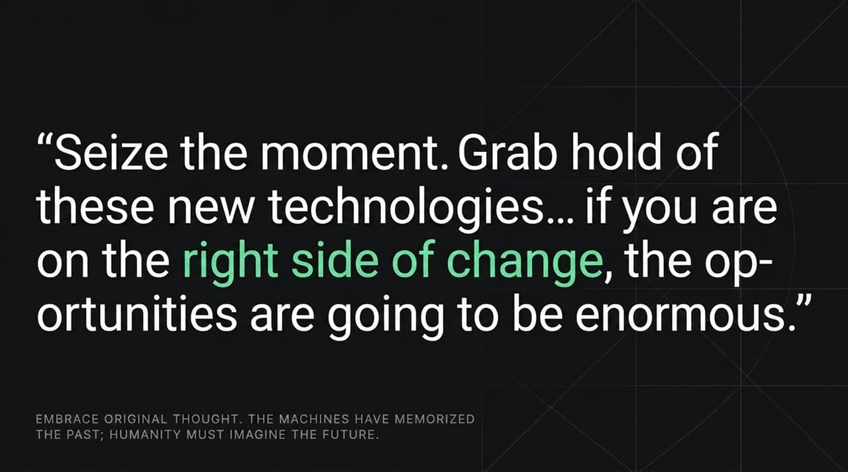

Slide 15
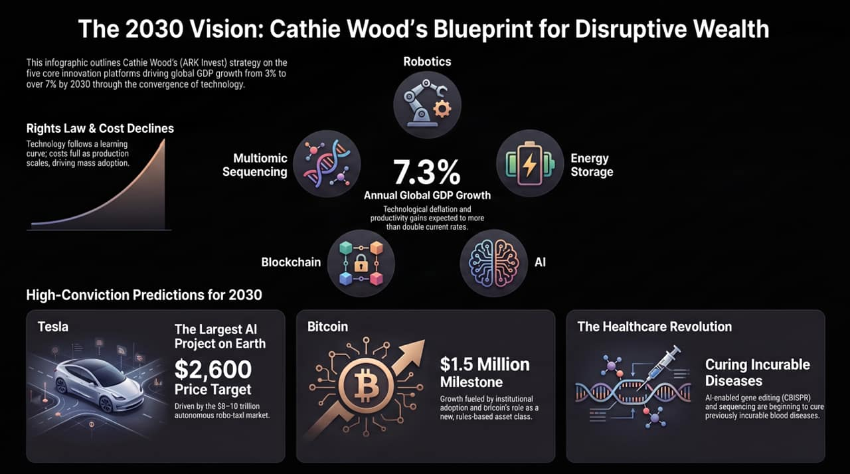
Notes:
To conclude, Cathie Wood’s 2030 blueprint highlights four key benchmarks:
Global Real GDP growth accelerating above 7.3%.
Tesla reaching a $2,600 price target driven by $8–10T autonomous networks.
Bitcoin surpassing $1.5 Million per coin.
Healthcare shifting to single-treatment genomic cures.

